Slide 1
Team FireStorm

Slide 2
TABLE OF CONTENTS
01
02
03
Our Team
Quote
What are we working on
04
05
06
Project goals
Quote
Predicted results
07
This is now

Slide 3
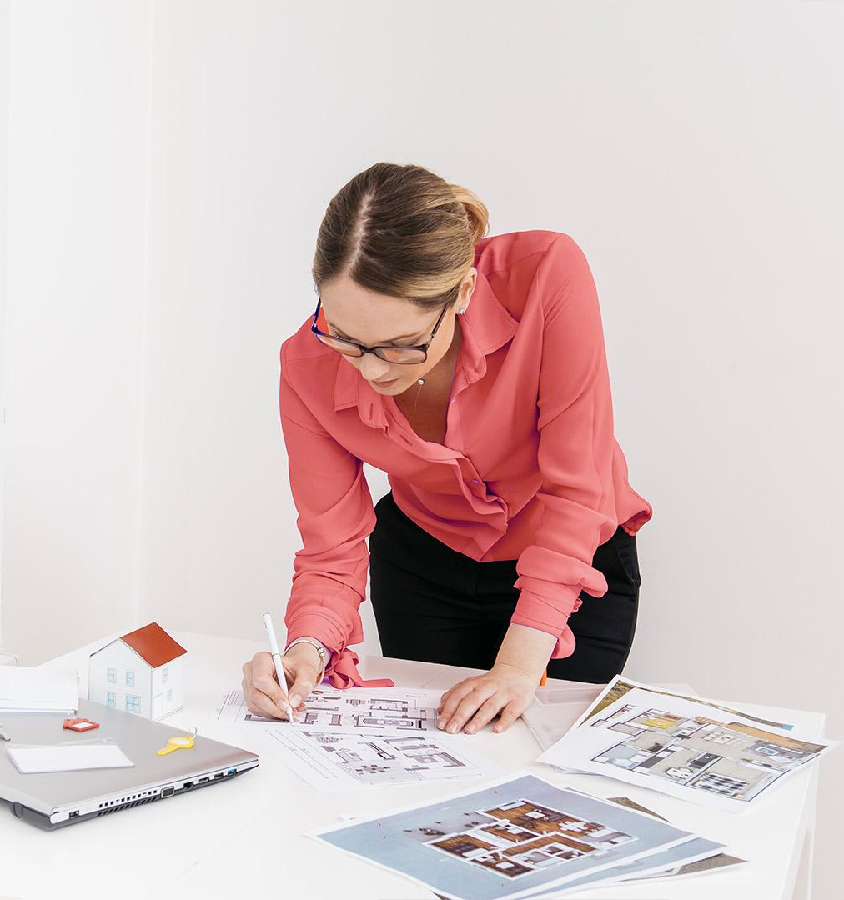
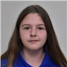
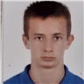
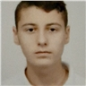
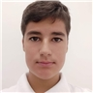
OUR TEAM
Our team consists of 4 people, each with a predetermined role and has his own tasks to do.
Ванина Тенева
Станимир Димитров
Мертин Дикмешефкет
Александър Цачев

Slide 4
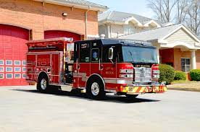
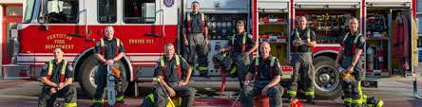
WHAT WE ARE WORKING ON
Our idea for this project activity is to make a fire safety site that includes advice on what to do in case of fire, statistics, photos and other pages.

Slide 5
—Voltaire
"The biggest reward for a thing well done is to have done it."

Slide 6

PROJECT GOALS
Our goal was to organize ourselves well as a team and create a website to help people in the event of a small accident and to inform them about fire safety.

Slide 7
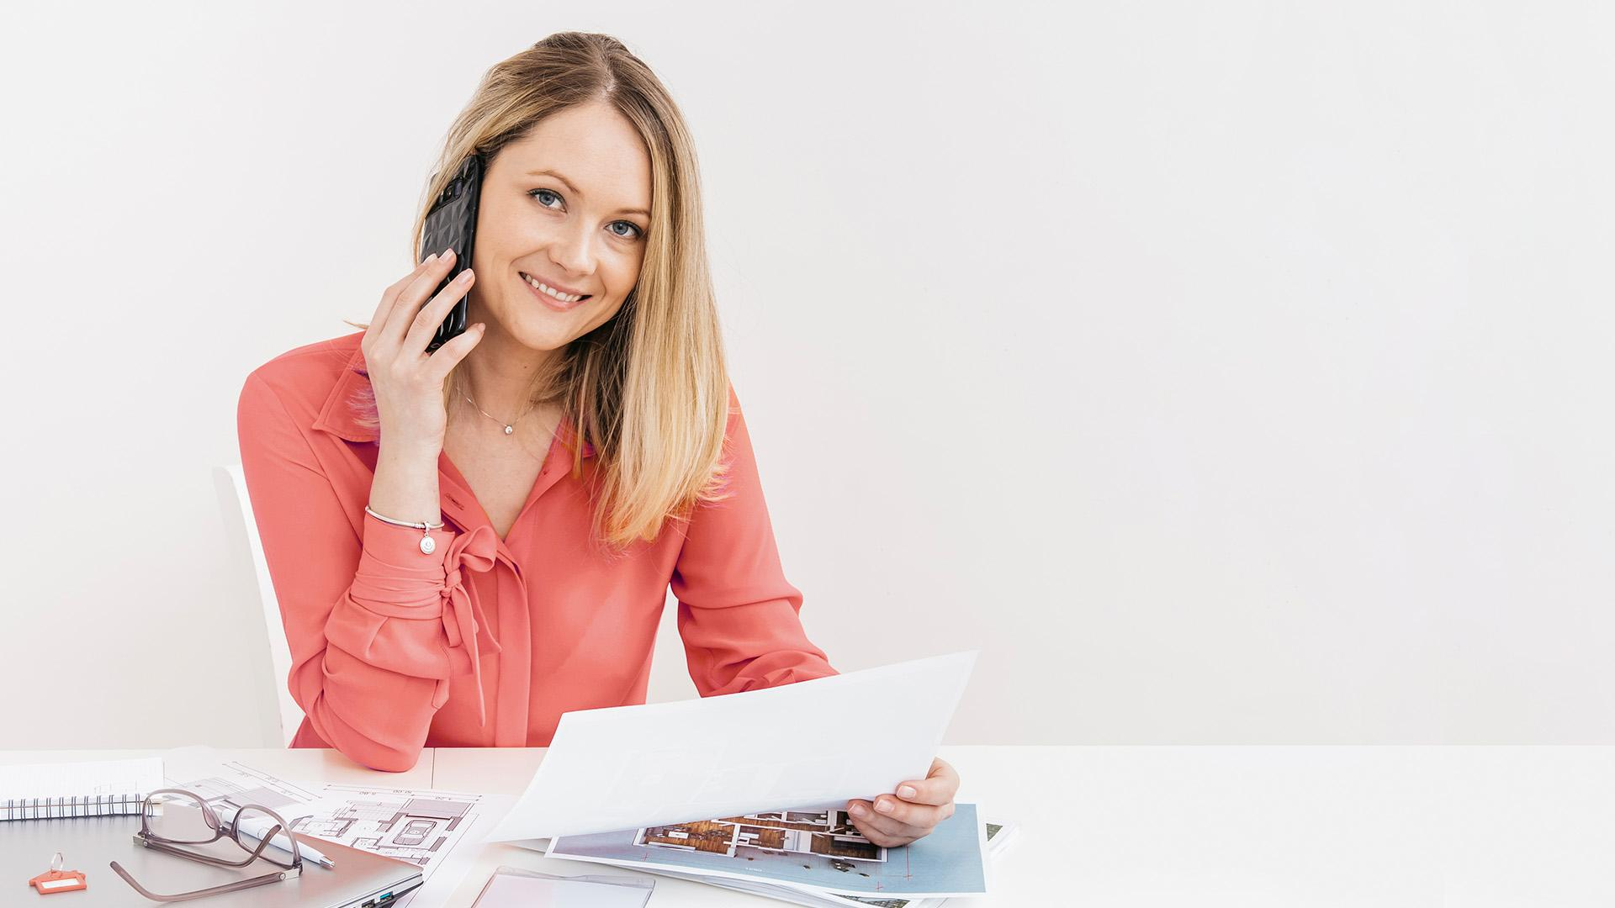
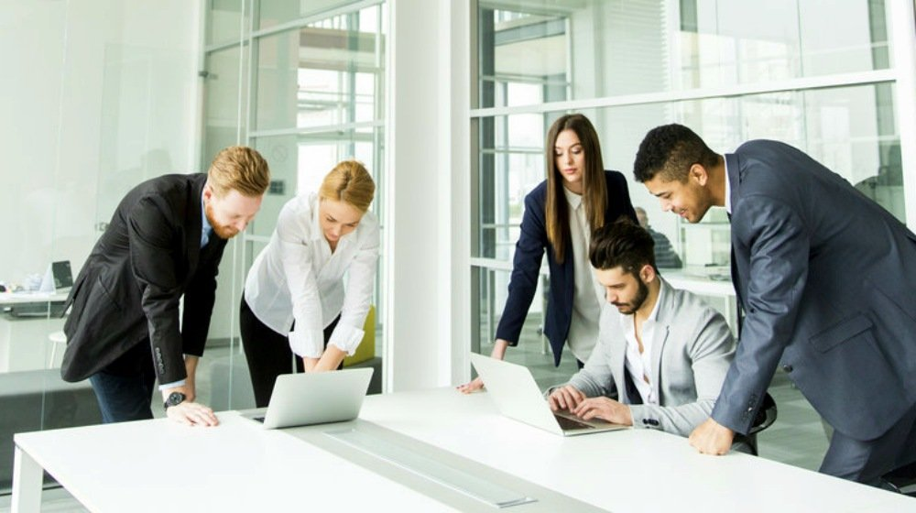
A PICTURE IS WORTH A THOUSAND WORDS

Slide 8
PREDICTED RESULTS
$20,000
88,000
Our predictions about the results,if we need to be completely honest with you,are not that big,not because we didn’t have the desire to work on this project,but because we found some difficulties while we were organising the whole project,our goals,our tasks and etcetera. But despite that,everything was okay,it was completely pleasantly to work with each other and to work on this project,because we have put a lot of efforts on this project,and we think we will success both individually and as a team!
There is no shortcut for hard work that leads to effectiveness. You must stay disciplined because most of the work is behind the scenes.
― Germany Kent

Slide 9
THIS IS NOW
Right now our team feels stronger than ever and we can claim that we were working hard to get to this point, and we think everybody can do it, but you must have the desire to do this,otherwise you will be stuck at one point

Slide 10

THANK YOU!!
If you can have any questions,feel free to ask us
either here or in the down-listed emails! Aleksander Tsatchev- AITsachev19@codingburgas.bg
Stanimir Dimitrov – SMDimitrov19@codingburgas.bg
Mertin Dikmeshefket – MSDikmeshefket19@codingburgas.bg
Vanina Teneva- VNTeneva19@codingburgas.bg

